Slide 1
Radont Mapping effort – June 2 2021
Andre Dekker
Medical Physicist, Professor of Clinical Data Science
Maastro Clinic, Maastricht University, Maastricht UMC+

Slide 2
Idea
What
Extract real data from clinical systems (EHR, Aria, Mosaiq, Raycare, PACS) and put it into an RDF graph using the radont ontology.
Why
Real-world test for ourselves in the radont group
Demo for others (esp. Big Data Subcommittee)
Scope
Focus on ASTRO-MDE & AAPM-OORO

Slide 3
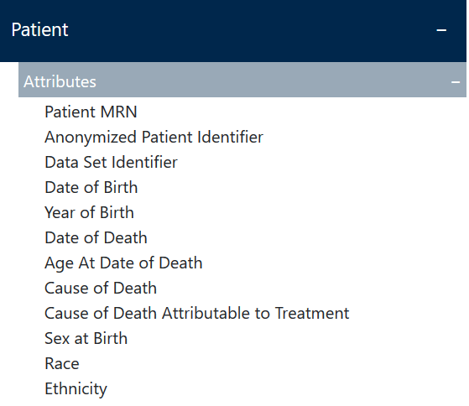
Patient demographics level - MDE & OORO
MDE: Does not say anything about this level
OORO, see right
Selection for now
Date of Birth
Sex
Name (although not on the list)

Slide 4
Plan of Action
Make a public fake Aria database
Map Aria patients (RDV) to a homo sapiens with the patient role (RDF) using R2RML (Ontop in Protégé)
Create a public virtual SPARQL endpoint using R2RML mapping & query
(Materialize the triples -> fighting with graphdb)
Upload the radont formal ontology & query
Make an ooro application ontology to define OORO:Patient
Upload the ooro application ontology, switch on inferencing & query

Slide 5

Setup
Maastro
ElephantSQL
(Cloud)
Azure (Cloud)
Aria
GraphDB
instances
Informatica
(ETL)
EDW
Informatica
(ETL)
‘Fake’
Aria
R2RML
SPARQL
HiX (EHR)
Master
Patient Index
radont.owl
ooro.owl
Protege
R2RML

Slide 6
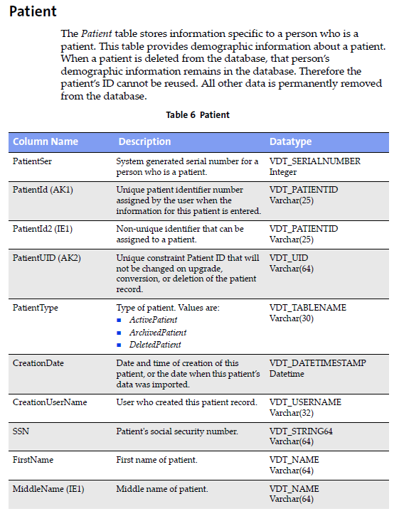
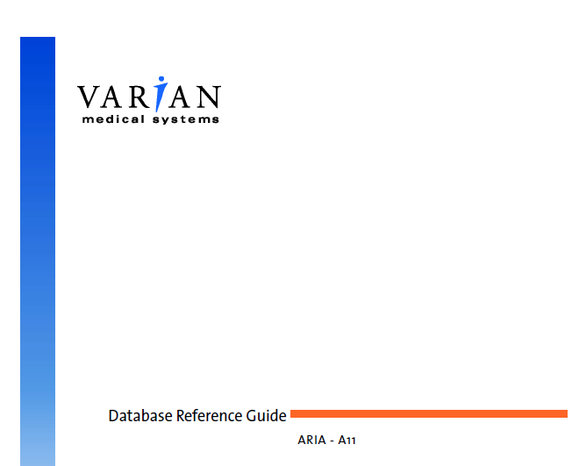
Aria

Slide 7

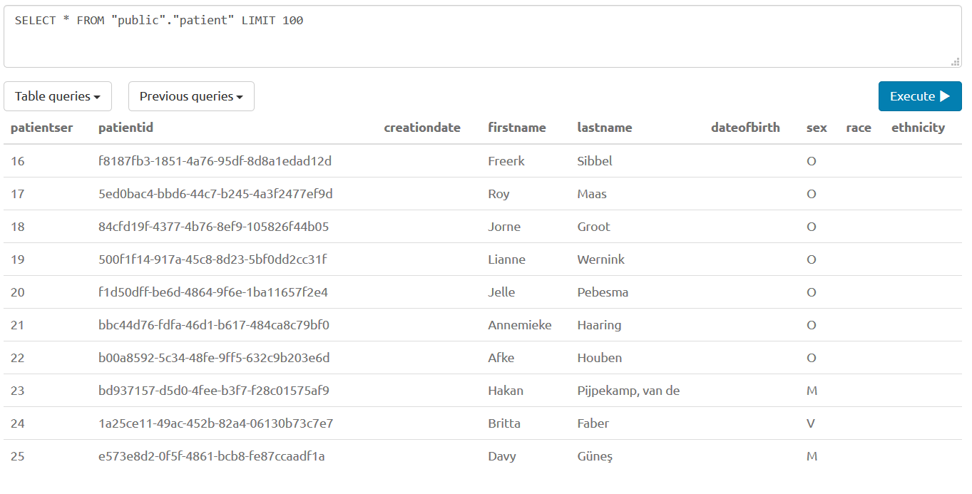
Fake Aria – Patient table
https://www.elephantsql.com/

Slide 8
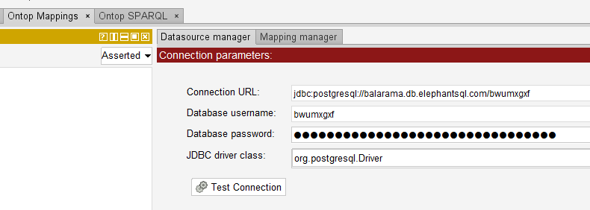
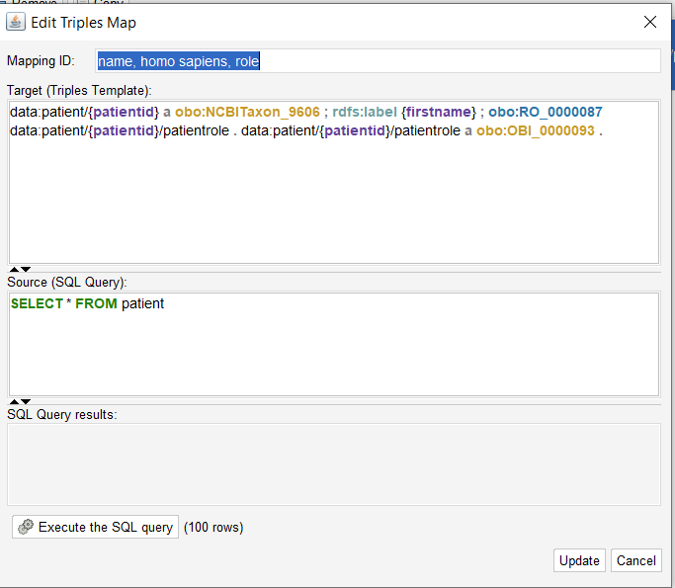
Protégé Mapping using Ontop
Ontop Protégé Bundel (https://sourceforge.net/projects/ontop4obda/files/ontop-4.1.0/)

Slide 9
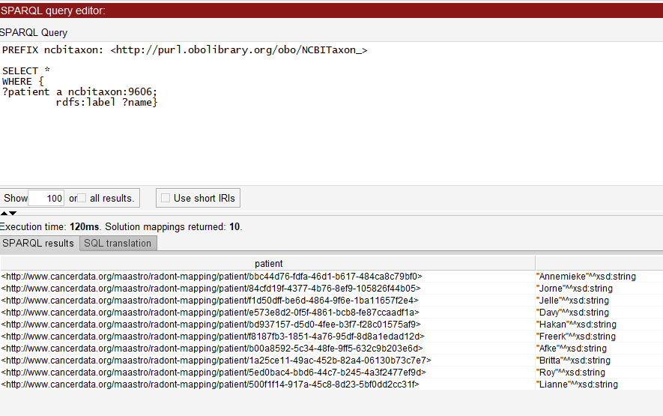
Tryout SPARQL via Protege

Slide 10
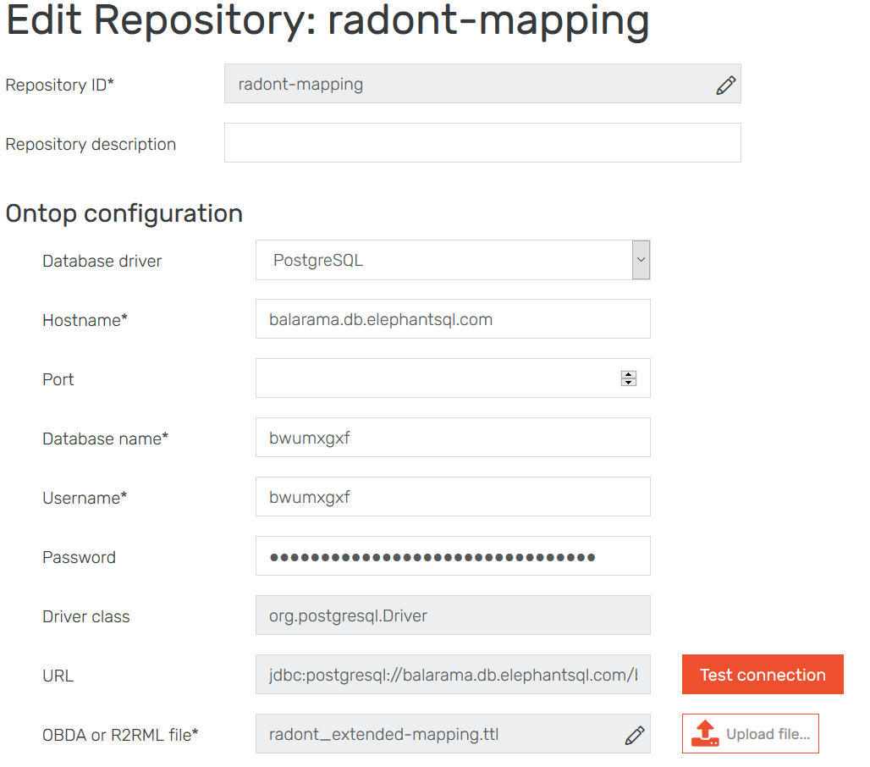
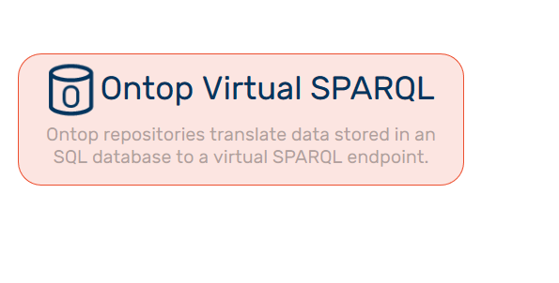
Move to GraphDB
Export mapping as R2RML file from Protege
Setup GraphDB Ontop Virutal SPARQL
Upload R2RML file

Slide 11
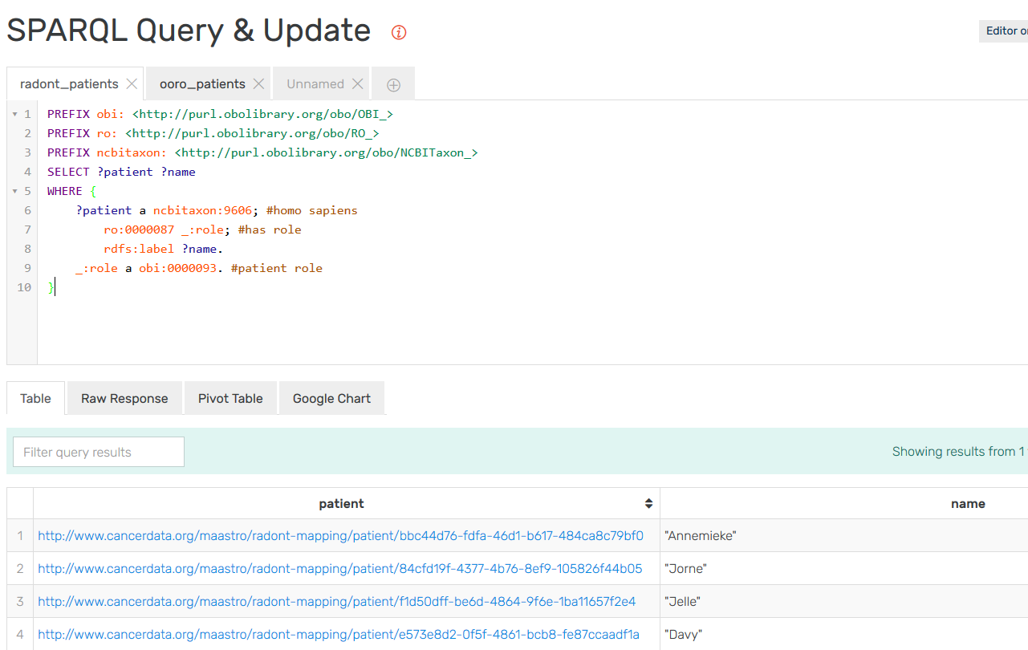
Query in GraphDB
http://20.56.33.226:7200/sparql

Slide 12
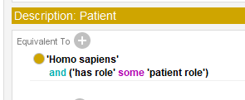
OROO view
Make an ooro application ontology in Protégé with OORO:Patient

Slide 13
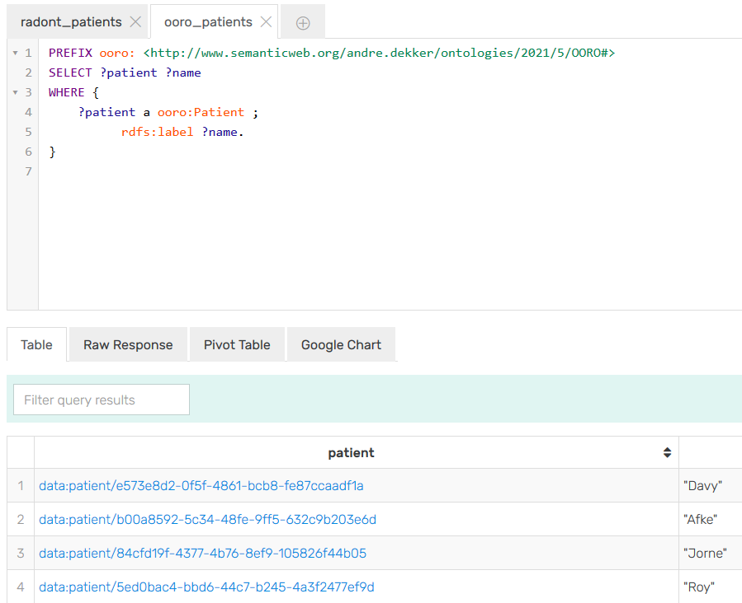
OROO view
Materialize triples (this should not be necessary) and make a Graph with materialized instances + radont + ooro
Switch inferencing on and off to see difference
(note that you could also map to OORO if that is easier…)

Slide 14
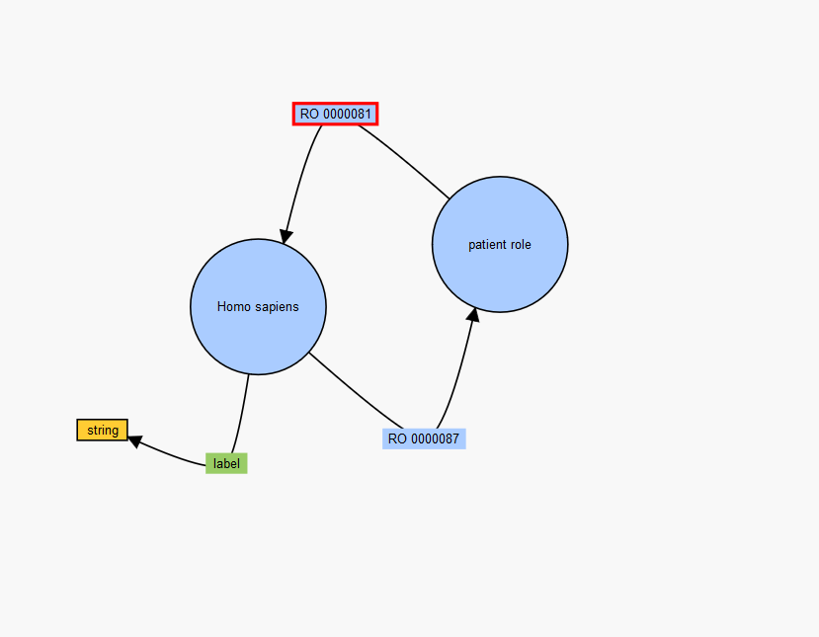
Useless fun
http://sparql.cancerdata.org/ld-vowl/#/graph?endpointURL=http:%2F%2Fsparql.cancerdata.org%2Fnamespace%2Fradont-mapping%2Fsparql

Slide 15
Open issues

Slide 16
Establish simple process for adding new imported terms/ontologies #16
@jonathanbona: I would also propose the following as part of the "import policy":
0. Select the ontology that has properly put the term you need in BFO (it happens regularly that the ontology that defined the concept and the ontology that imported it and put it into BFO are different, select the latter)
1. Select the term you need as the low level source term URIs in Ontofox
2. Select the first BFO parent as the top level source term URI in Ontofox
3. Set includeNoIntermediates (alternative is to includeAllIntermediates but that gives a lot of overhead?)
4. Include the following annotations
http://www.w3.org/2000/01/rdf-schema#label
http://purl.obolibrary.org/obo/IAO_0000115
@jonathanbona : I would also propose the following as part of the "import policy"
We will import all entities we need in our domain into the radont ontology, provided that they follow BFO. We want to end up in a situation where to map data in our domain, you only need to have the radont ontology.
Any other entity, i.e. one not following BFO, should be placed in an application ontology.
radont does not import all axioms, i.e. if one want to do full inferencing you need to import the source ontologies.

Slide 17
Homo sapiens #29
The most often used Homo Sapiens is from NCBIT not NCIT. But NCIT also has homo sapiens defined. @jonathanbona: In the above comment, do you indeed suggest using the NCIT or is this a typo and do you vote for using the NCBIT one?
Homo sapiens defined in NCBIT but other ontologies have put it in its right place as a material entity, e.g. OBI. Should we import from there? At the moment it is not properly imported into radont.

Slide 18
Given name, Family name #34
Will we choose OPMI or PNO for the name. Suggestion: OPMI
OPMI has defined person first name and person last name (and more extensive things like maiden name, middle name etc). The tree is
generically dependent continuant
information content entity
textual entity
person name
person first name
PNO can apparently use the IAO namespace (?) has defined a personal name IAO_0020015 (which does not resolve btw) in the tree generically dependent continuant
information content entity
Identifier
personal name
given name
family name

Slide 19
Given name, Family name #34
@jonathanbona : What property do i use to give someone a certain name? And which one to set a value?
Typically it would be something like below, but what do i use for ?1 and ?2
<andre> a homo sapiens
<andre> ?1 <name>
<name> a givenname
<name> ?2 "andre"

Slide 20
SPARQL
PREFIX obi: <http://purl.obolibrary.org/obo/OBI_>
PREFIX ro: <http://purl.obolibrary.org/obo/RO_>
PREFIX ncbitaxon: <http://purl.obolibrary.org/obo/NCBITaxon_>
SELECT ?patient
WHERE {
?patient a ncbitaxon:9606; #homo sapiens
ro:0000087 _:role. #has role
_:role a obi:0000093 . #patient role
}

Slide 21
SPARQL
PREFIX ooro: <http://www.semanticweb.org/andre.dekker/ontologies/2021/5/OORO#>
SELECT ?patient
WHERE {
?patient a ooro:Patient .
}

Slide 22
VOWL blacklist
http://purl.obolibrary.org/obo/BFO_0000001,
http://purl.obolibrary.org/obo/BFO_0000002,
http://purl.obolibrary.org/obo/BFO_0000003,
http://purl.obolibrary.org/obo/BFO_0000004,
http://purl.obolibrary.org/obo/BFO_0000005,
http://purl.obolibrary.org/obo/BFO_0000040,
http://purl.obolibrary.org/obo/BFO_0000017,
http://purl.obolibrary.org/obo/BFO_0000020,
http://purl.obolibrary.org/obo/BFO_0000023,
http://www.w3.org/2002/07/owl#Axiom,
http://www.w3.org/1999/02/22-rdf-syntax-ns#List,
http://www.w3.org/1999/02/22-rdf-syntax-ns#langString,
http://www.w3.org/1999/02/22-rdf-syntax-ns#HTML,
http://www.w3.org/1999/02/22-rdf-syntax-ns#XMLLiteral,
http://www.w3.org/1999/02/22-rdf-syntax-ns#Property,
http://www.w3.org/1999/02/22-rdf-syntax-ns#Bag,
http://www.w3.org/1999/02/22-rdf-syntax-ns#Seq,
http://www.w3.org/1999/02/22-rdf-syntax-ns#Alt,
http://www.w3.org/2000/01/rdf-schema#Resource,
http://www.w3.org/2000/01/rdf-schema#Literal,
http://www.w3.org/2000/01/rdf-schema#Class,
http://www.w3.org/2000/01/rdf-schema#Datatype,
http://www.w3.org/2000/01/rdf-schema#Statement,
http://www.w3.org/2000/01/rdf-schema#Container,
http://www.w3.org/2000/01/rdf-schema#ContainerMembershipProperty,
http://www.w3.org/2002/07/owl#AllDifferent,
http://www.w3.org/2002/07/owl#AnnotationProperty,
http://www.w3.org/2002/07/owl#Class,
http://www.w3.org/2002/07/owl#DataRange,
http://www.w3.org/2002/07/owl#DatatypeProperty,
http://www.w3.org/2002/07/owl#DeprecatedClass,
http://www.w3.org/2002/07/owl#DeprecatedProperty,
http://www.w3.org/2002/07/owl#FunctionalProperty,
http://www.w3.org/2002/07/owl#IrreflexiveProperty,
http://www.w3.org/2002/07/owl#InverseFunctionalProperty,
http://www.w3.org/2002/07/owl#Nothing,
http://www.w3.org/2002/07/owl#ObjectProperty,
http://www.w3.org/2002/07/owl#Ontology,
http://www.w3.org/2002/07/owl#OntologyProperty,
http://www.w3.org/2002/07/owl#Restriction,
http://www.w3.org/2002/07/owl#SymmetricProperty,
http://www.w3.org/2002/07/owl#Thing,
http://www.w3.org/2002/07/owl#TransitiveProperty

Slide 23
VOWL blacklist - 2
http://purl.obolibrary.org/obo/RO_0000052,
http://purl.obolibrary.org/obo/RO_0000053,
http://www.w3.org/1999/02/22-rdf-syntax-ns#type,
http://www.w3.org/1999/02/22-rdf-syntax-ns#first,
http://www.w3.org/1999/02/22-rdf-syntax-ns#rest,
http://www.w3.org/1999/02/22-rdf-syntax-ns#value,
http://www.w3.org/1999/02/22-rdf-syntax-ns#subject,
http://www.w3.org/1999/02/22-rdf-syntax-ns#predicate,
http://www.w3.org/1999/02/22-rdf-syntax-ns#object,
http://www.w3.org/2000/01/rdf-schema#subClassOf,
http://www.w3.org/2000/01/rdf-schema#subPropertyOf,
http://www.w3.org/2000/01/rdf-schema#domain,
http://www.w3.org/2000/01/rdf-schema#range,
http://www.w3.org/2000/01/rdf-schema#label,
http://www.w3.org/2000/01/rdf-schema#comment,
http://www.w3.org/2000/01/rdf-schema#member,
http://www.w3.org/2000/01/rdf-schema#seeAlso,
http://www.w3.org/2000/01/rdf-schema#isDefinedBy,
http://www.w3.org/2002/07/owl#allValuesFrom,
http://www.w3.org/2002/07/owl#backwardCompatibleWith,
http://www.w3.org/2002/07/owl#cardinality,
http://www.w3.org/2002/07/owl#complementOf,
http://www.w3.org/2002/07/owl#differentFrom,
http://www.w3.org/2002/07/owl#disjointWith,
http://www.w3.org/2002/07/owl#distinctMembers,
http://www.w3.org/2002/07/owl#equivalentClass,
http://www.w3.org/2002/07/owl#equivalentProperty,
http://www.w3.org/2002/07/owl#hasValue,
http://www.w3.org/2002/07/owl#imports,
http://www.w3.org/2002/07/owl#incompatibleWith,
http://www.w3.org/2002/07/owl#intersectionOf,
http://www.w3.org/2002/07/owl#inverseOf,
http://www.w3.org/2002/07/owl#maxCardinality,
http://www.w3.org/2002/07/owl#minCardinality,
http://www.w3.org/2002/07/owl#oneOf,
http://www.w3.org/2002/07/owl#onProperty,
http://www.w3.org/2002/07/owl#priorVersion,
http://www.w3.org/2002/07/owl#sameAs,
http://www.w3.org/2002/07/owl#someValuesFrom,
http://www.w3.org/2002/07/owl#unionOf,
http://www.w3.org/2002/07/owl#versionInfo

